Slide 1
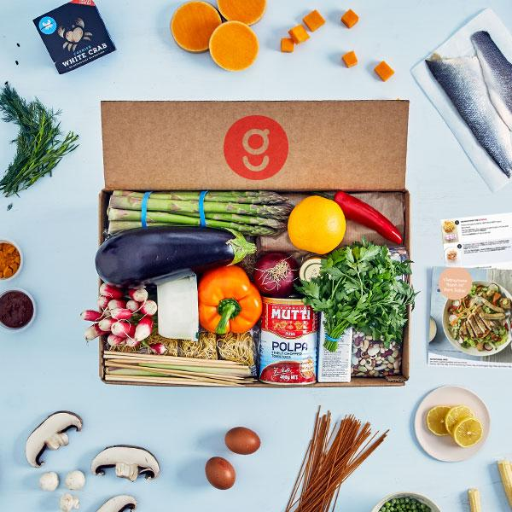
Presentation II:
Recipe Subscription Service
Machine Learning Model
Sanjay Krishna Moorthy
Viswashanthi Bonala
Mitchell Moreno
Sneha Dudyala
Susmitha Haripriya Varanasi

Slide 2
Presentation Outline
Business Scenario
What is our business / What is the problem we are trying to solve?
Data Explanation
Gathering & Formatting Data
Variables Description
Machine Learning Solution
Q & A
Notes:
sanjay

Slide 3
Recap of Previous Presentation
Notes:
sanjay

Slide 4

Business Scenario
Recipe Subscription Service: Ex. Blue Apron, Hello Fresh
Weekly delivery of ingredients that are ordered by customers
How can we improve our subscriber retention rate? (ie. keep subscribers from leaving)
To increase profits we need to keep our subscribers
We can use Machine Learning!
Notes:
Sanjay

Slide 5
Data Explanation
1.Source of Data and Context
We have two data sets which are collected from Kaggle (Food.com - Recipes and Reviews)
Recipes Dataset
From the data obtained online there are 522,517 recipes. The data set gives multiple descriptive variables about each type of recipe, i.e ingredients, health related variables, etc
Reviews Dataset
There is about 1.4 Million reviews left by a total of 271,907 different users. The data set has info on rating, author, review text, etc.
Notes:
sushmitha

Slide 6
Format and Data Description
These datasets are in two different formats:
We will be using CSV formatted files because it is easier to work with in python.
From reviews dataset we have reviews and ratings that come from different authors for different recipes
From recipes dataset we can get detail recipes description and time taken to prepare food.
We will be using a joined dataframe of the recipes and reviews file for our data analysis.
Notes:
sushmitha

Slide 7
Exploration of Data
In our combined dataframe, there are:
798,270 reviews
157,500 reviewers
229,665 recipes
9853 ingredients used
285 recipe categories
Notes:
mitchell

Slide 8
Variable Description
Variables used in Modeling
ReviewerId (To indicate the user)
RecipeId (To indicate the recipe)
Rating (Rating provided by specific Reviewer for a given Recipe)
Notes:
mitchell

Slide 9
Recommendation Model

Slide 10
Machine Learning Model
Alternating Least Square (ALS) to solve our problem of customer retention.
The ALS uses matrix factorization to determine recommendations.
Notes:
mitchell

Slide 11
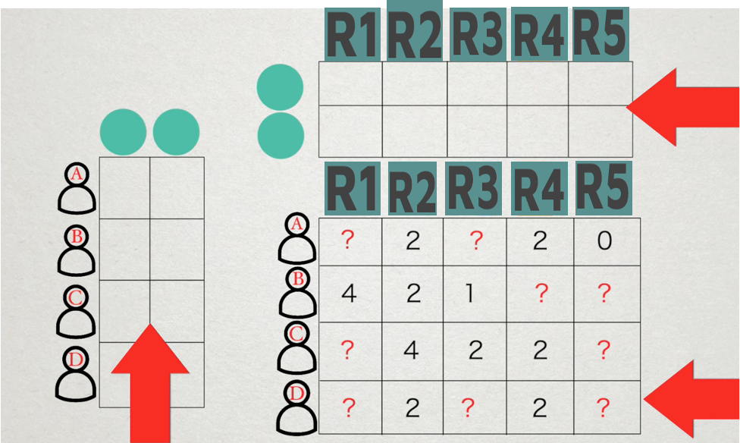
ALS Collaborative Filtering
Notes:
sanjay

Slide 12
ALS Model In Application
In our current model, we are passing reviewer id and recipeid and recommending based on rating.
The recommendation system takes the top rated recipes for each reviewer and recommends three recipes when he wants to order again.
To improve our subscriber retention rate (ie. keep subscribers from leaving) and to increase profits we need to keep our subscribers
The recommendations saves customer’s search time and attracts the customers.
Notes:
shanthi

Slide 13
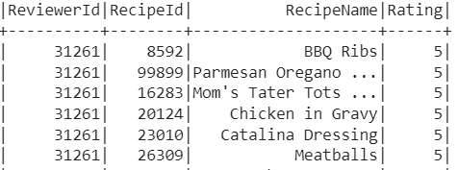
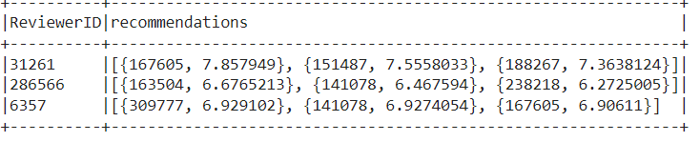
Notes:
shanthi

Slide 14
The ALS model recommended the Customer 31261 - Teresa M 167605-Grilled Baby Vegetables
151487 - Pain Au Chocolate
188267-Healthy Oatmeal Banana Chocolate Muffins
Based on her previous ratings.
Notes:
shanthi

Slide 15
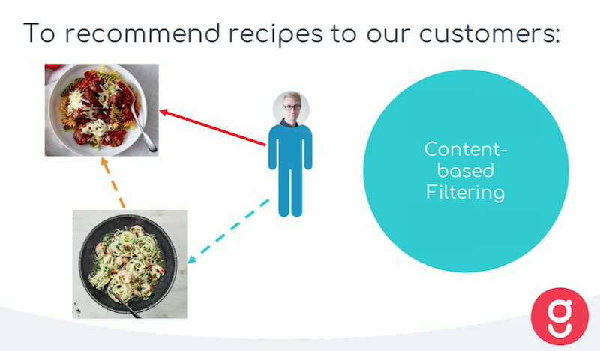
Nearest Neighbor item based collaborative Filtering
We have used content based collaborative filtering.

Slide 16
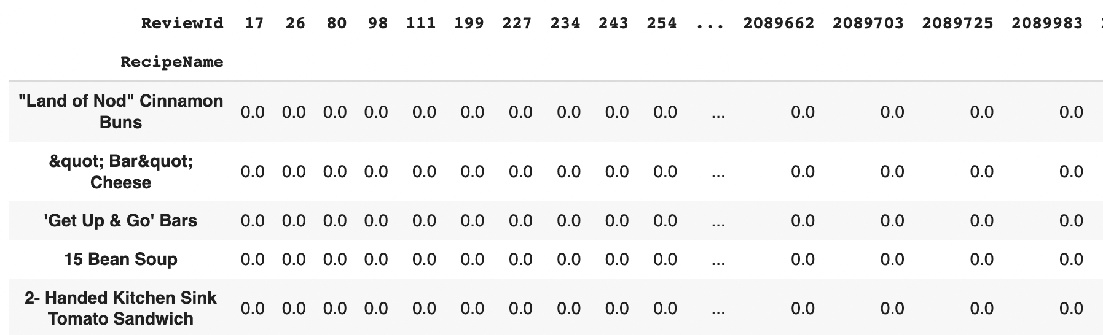
Pre Processing Steps:
Finding out the count of reviews for each recipe.
Merge count of reviews with data.
Set the threshold value as 50 and filter the data with count of reviews more than threshold value.
Create a pivot table with index-recipe name, columns-review id and values-rating.
Create a sparse matrix of compressed sparse row format.

Slide 17
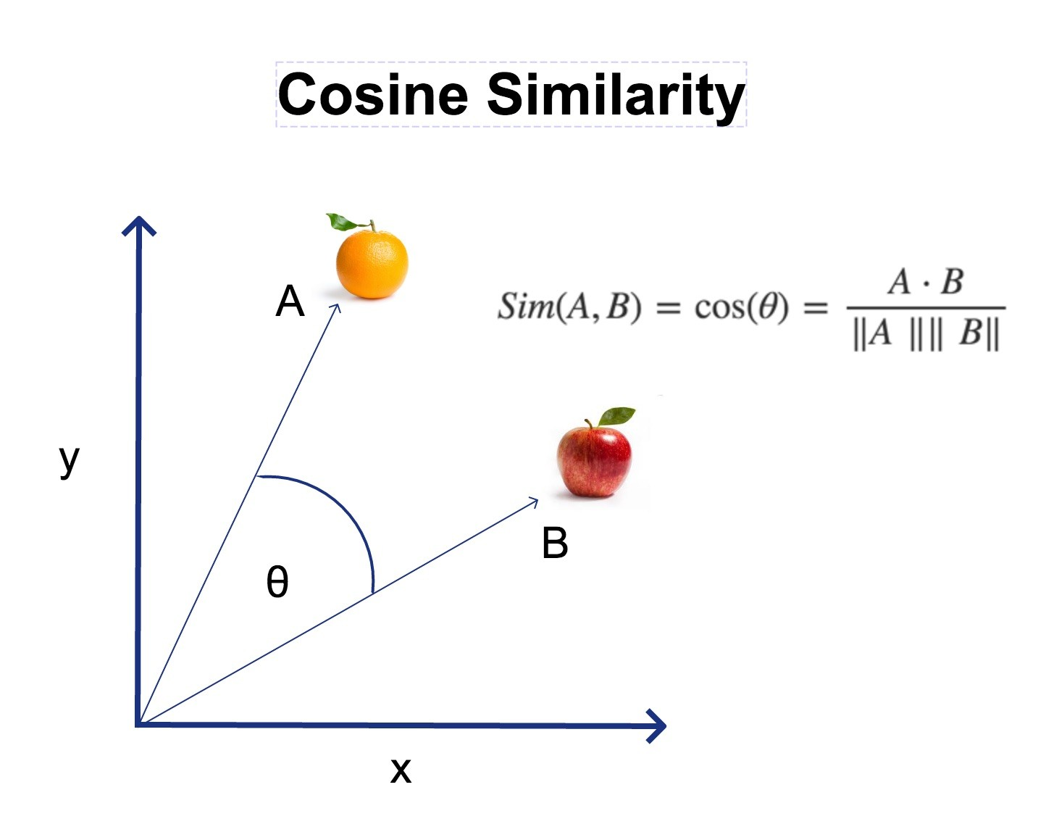
Model Building
Model Parameters:
K value: 5
Algorithm: brute
Metric: Cosine

Slide 18
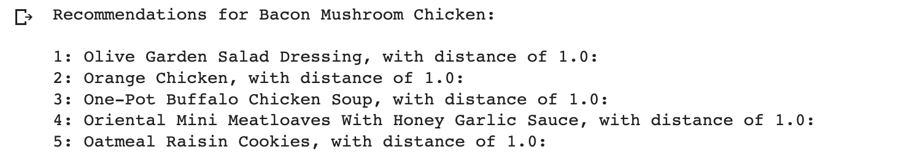
Model Result:

Slide 19
Q&A

Slide 20
References
https://www.kaggle.com/datasets/irkaal/foodcom-recipes-and-reviews
Reviews Data File:
https://drive.google.com/file/d/1F0-ASQ7DJagtpugLqvQhDPggbQkwwjRm/view?usp=sharing
Recipes Data File:
https://drive.google.com/file/d/1-1VAw_qINDSeV_PBD-ylF0DnkDwL_wGt/view?usp=sharing

